Slide 1

21 BIO 112 INTELLIGENCE OF BIOLOGICAL SYSTEMS II
AKHILESH P - BL.EN.U4AIE21006
AMAL KRISHNA K - BL.EN.U4AIE21008
AHN KARTHIK - BL.EN.U4AIE21012

Slide 2
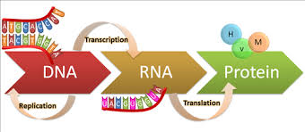
PROTEIN SYNTHESIS

Slide 3
CONTENTS
Introduction
DNA
DNA Replication
Transcription
Genetic Code
Translation
Python Code
Conclusion

Slide 4
PROTEIN SYNTHESIS
Protein synthesis is the process whereby DNA encodes for the production of amino acids and proteins.
It is a very complex and precise process and as proteins make up over half of the dry mass of a cell, it is a vital process to the maintenance, growth and development of the cell.
DNA contains the information (genetic code) that tells the cells how to make proteins. The flow of this information in a cell is from DNA to RNA to Protein.

Slide 5
This flow of information can be divided into two parts DNA to RNA and RNA to Protein.
The flow of information from DNA to RNA occurs through a process called DNA transcription.
And, flow from RNA to proteins occurs through DNA translation.
So, the process of Protein synthesis consists of two major processes DNA transcription and DNA translation.

Slide 6

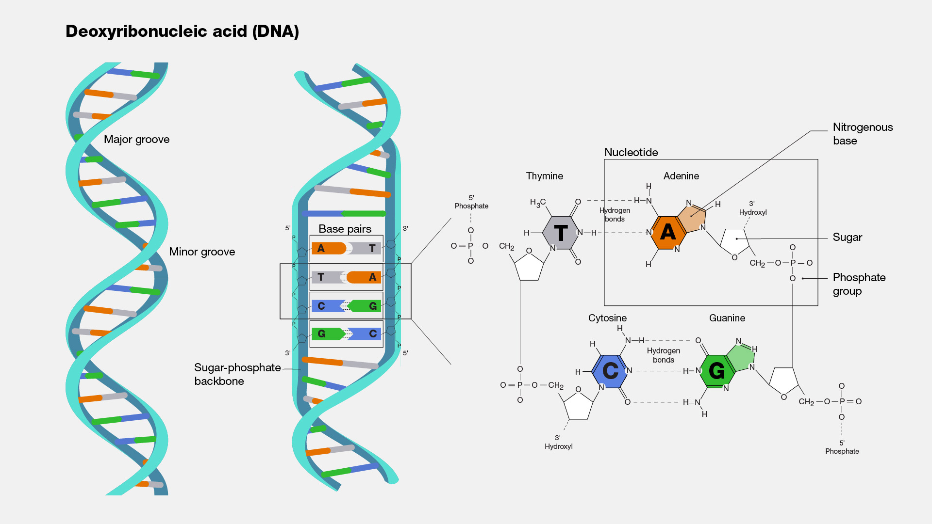
DNA
Structure of Polynucleotide Chain
Polymer of deoxyribonucleotides

Slide 7
Nucleoside = Nitrogenous base + Pentose sugar (linked through N − glycosidic bond)
Nucleotide = Nucleoside + Phosphate group (linked through phosphodiester bond)
Many nucleotides link together through 3′ − 5′ phosphodiester bond to form polynucleotide chain (as in DNA and RNA).
DNA requires RNA for protein synthesis. DNA → RNA → Protein
RNA directly codes for proteins

Slide 8
Genome
A genome is an organism’s complete set of genetic instructions
It’s the DNA Sequence
Its the order in which the nucleotides are arranged in the DNAs .
Each genome contains all of the information needed to build that organism and allow it to grow and develop.
Human genome contains 3.2 billion base pairs.

Slide 9
What is DNA Replication?
DNA replication is the phenomenon in which a duplicate copy of DNA is synthesised.
In replication, two strands of the DNA helix separate and each strand acts as a template for synthesising new complementary strands.
After completion of replication, the two copies so produced will have one parental and one newly synthesised strand. This scheme of replication is called semi-conservative replication.

Slide 10
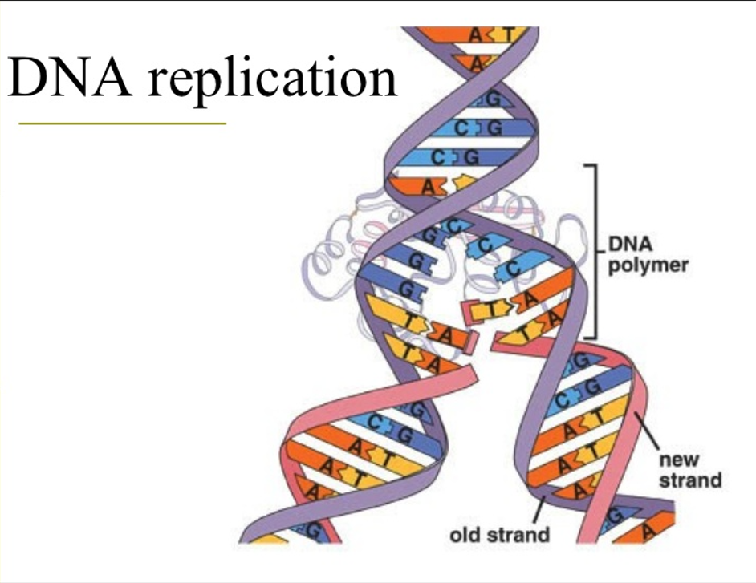

Slide 11
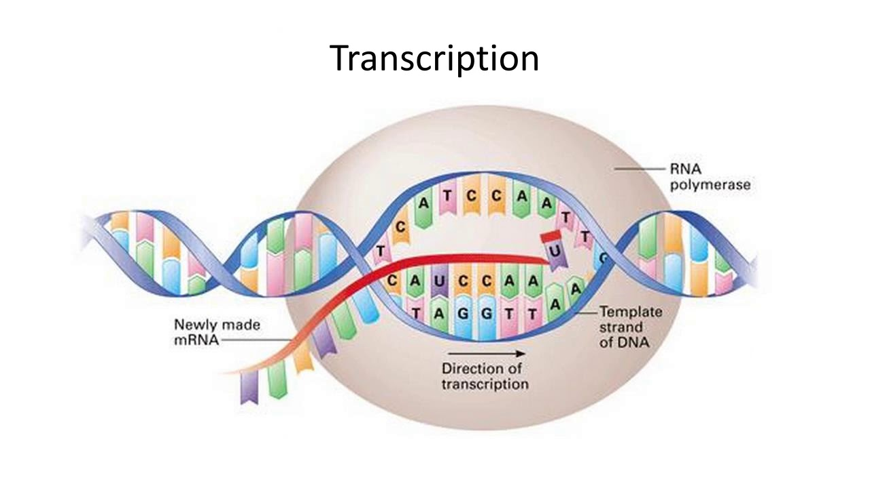
Transcription is the process of formation of RNA molecules from the DNA.

Slide 12
During transcription, only a segment of DNA from only one of of the strands participates.
Both strands are not copied during transcription because:
If both strands get transcribed at the same time since the sequences of amino acid would be different in both (due to complementarity), then two RNA molecules with different sequences will be formed, which in turn give rise to two different proteins. Therefore, one DNA would end up giving rise to two different proteins.
Two RNA molecules so formed will be complementary to each other, hence would end up forming a double-stranded RNA leaving the entire process of transcription futile

Slide 13
Transcriptional Unit
A transcriptional unit has primarily three regions:
Promoter − Marks the beginning of transcription; RNA polymerase binds here
Structural gene − Part of the DNA that is actually transcribed
Terminator − Marks the end of transcription
DNA has the genetic code for the protein that needs to be made, but proteins are made by the ribosomes—ribosomes are outside the nucleus in the cytoplasm.
DNA is too large to leave the nucleus (double stranded), but RNA can leave the nucleus (single stranded).

Slide 14
Types of RNA
mRNA (messenger RNA) − It serves as a template for protein synthesis. DNA is transcribed to form an mRNA, which in turn is translated to form protein.
tRNA (transfer RNA) − It brings amino acids during translation and reads the genetic code.
rRNA (ribosomal RNA) − These are the work benches of translation. They play a structural and catalytic role during translation.

Slide 15
Genetic Code
Genetic code directs the sequence of amino acids during the synthesis of proteins.
Salient features of genetic code:
The 3 mRNA bases are known as the codon, the 3 tRNA bases that match up are the anti-codon.
Codon is triplet. 4^3 = 64 (61 codons code for amino acids while 3 are stop codons)
One codon codes for a single specific amino acid. Codons are unambiguous.
Codons are degenerate since some amino acids are coded by more than one codon.
Genetic code is universal. 1 codon codes for same amino acid in all species.
Codons are read continuous. They lack punctuations.
AUG has dual functions − Codes for Methionine and acts as a start codon

Slide 16
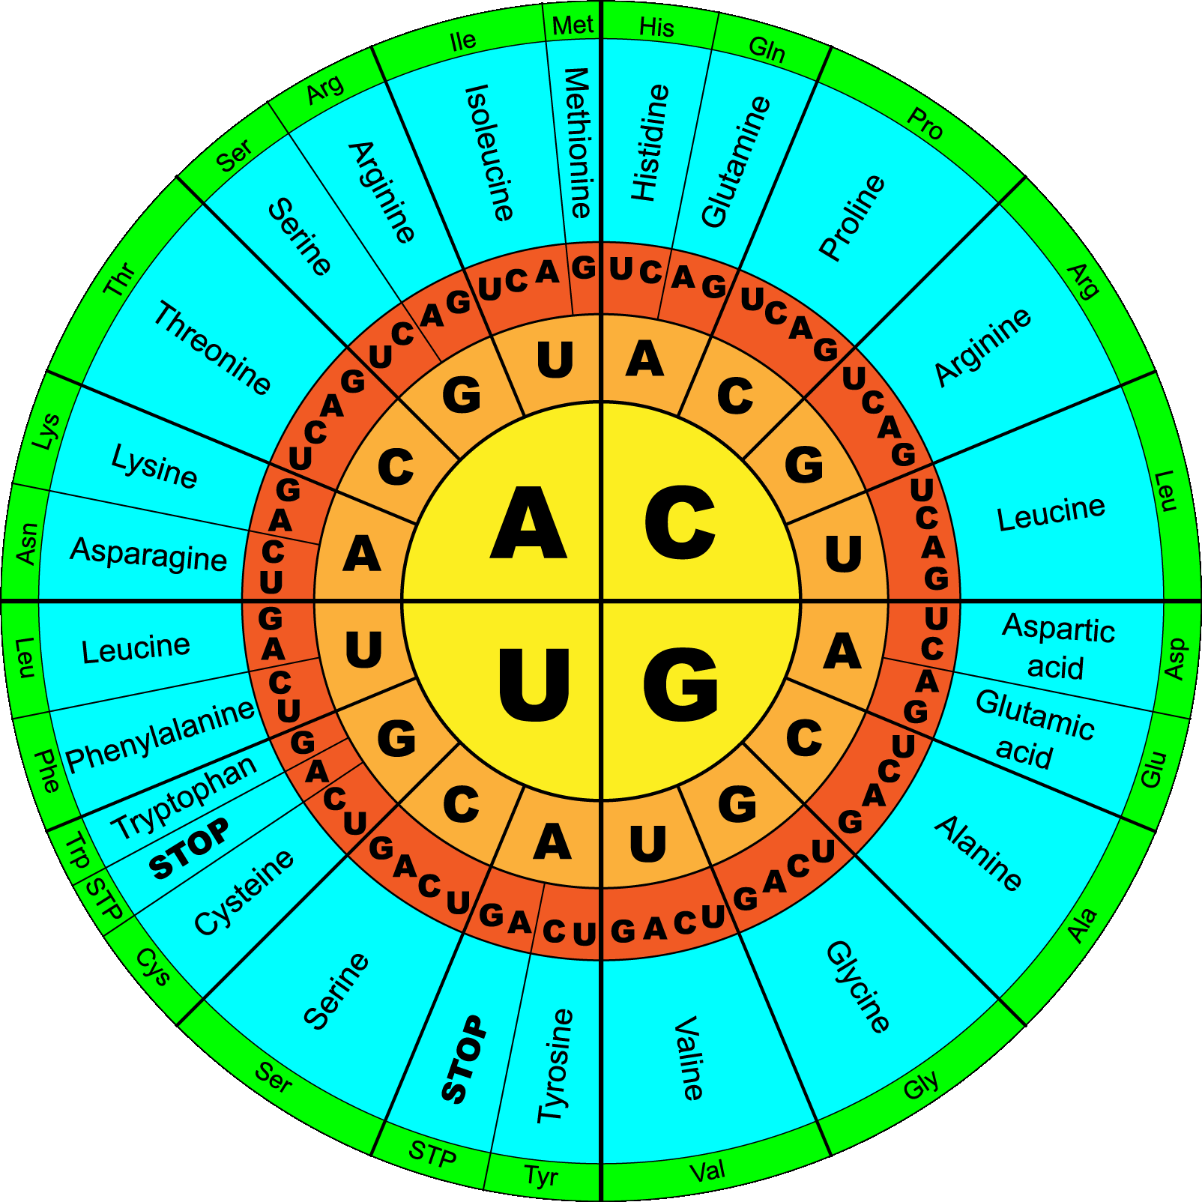
Image showing the codons and the respective amino acids
Start codon:
AUG
Stop codons:
UAG
UGA
UAA

Slide 17
Translation
The information encoded in DNA is transferred to messenger RNA and then decoded by the ribosome to produce proteins
The major molecules involved in translation are:
-Messenger RNA (mRNA)
-Transfer RNA (tRNA)
-Ribosomes
-Enzymes, other factors, energy sources

Slide 18
5’-ATGCAATACTGCGATTGA-3’
3’-TACGTTATGACGCTAACT-5’
DNA
Transcription
5’-AUGCAAUACUGCGAUUGA-3’
mRNA
decoded as
5’-AUG CAA UAC UGC GAU UGA-3’
Translation
N-MET-GLN-TYR-CYS-ASP-C
Protein

Slide 19
tRNA
tRNA is an adapter molecule. On one hand, it reads the genetic code and on the other hand, it binds to specific amino acids.
Transfer RNA (tRNA) carries amino acids from the cytoplasm to the ribosome.
tRNA has an anticodon loop that has bases complementary to the mRNA code and an amino acid acceptor end where it binds to the corresponding amino acid.
Initiation tRNA − This tRNA is essential for initiation of translation and has AUG in anticodon loop and Met in amino acid acceptor end.
There are no tRNAs for stop codons.

Slide 20
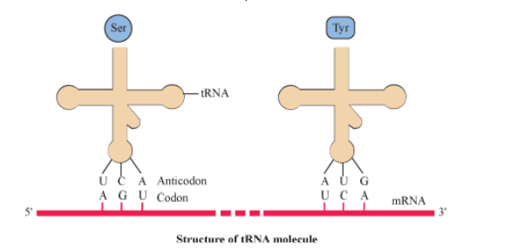
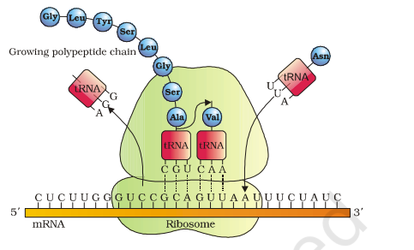

Slide 21
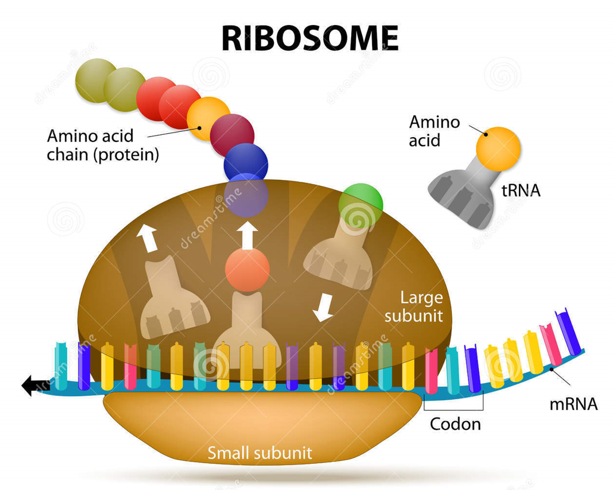
Ribosome
Very small particles that are key components in protein synthesis
Are found as subunits in the cytoplasm and attached to ER.
One subunit is larger one while the other one is smaller in size.
Chemically they are a combination of ribonucleic acid with proteins
They assemble on the mRNA when translation begins. Bind to mRNA and help to initiate translation

Slide 22
How Translation Works
tRNA becomes charged by picking up an amino acid.
This is done by the enzyme “amino-acyl tRNA synthetase.
One synthetase for each amino acid
A single synthetase may recognize multiple tRNAs
for the same amino acid
5’ end of mRNA comes together with 2 ribosome subunits:

Slide 23
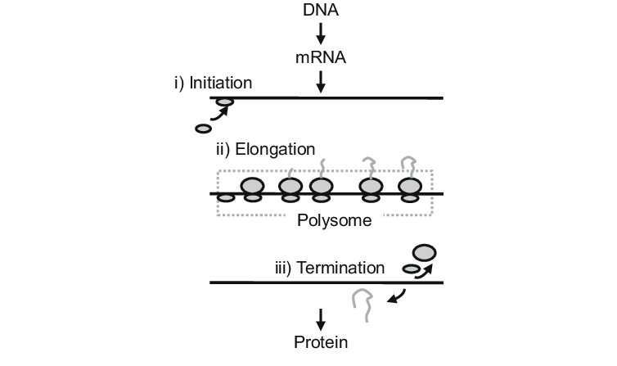
Steps in Translation
Once the tRNA is charged, translation can begin
It will occur in 3 steps:
Initiation
Elongation
Termination

Slide 24
Initiation :
-> Protein synthesis starts when a charged tRNA reaches at the region of mRNA. This mRNA provide as a site or template by associating with ribosome.
-> Initiator tRNA recognizes the start codon
-> Initiation factors also helps in this process.
-> Then t-RNA-amino acid complexes bind to their corresponding codon on the mRNA and base pairing occurs between codon on mRNA and tRNA anticodon.
Elongation :
-> When a second transfer RNA carrying amino acid reaches at the site it moves 3 steps forward until the amino acids are arranged in the form of a chain. The adjacent amino acids are connected to each other by peptide bonding.
-> i.e. tRNA moves from codon to codon on the mRNA and amino acids are added one by one.
-> The enzyme peptidyl transferase helps for this.

Slide 25
Termination :
-> The process of elongation continues until it reaches the terminator region where the termination factors are seen.
-> Termination of translation is triggered by stop codons.
- >When the stop codon is reached
a protein chain is released and
ribosome split into its sub units.

Slide 26
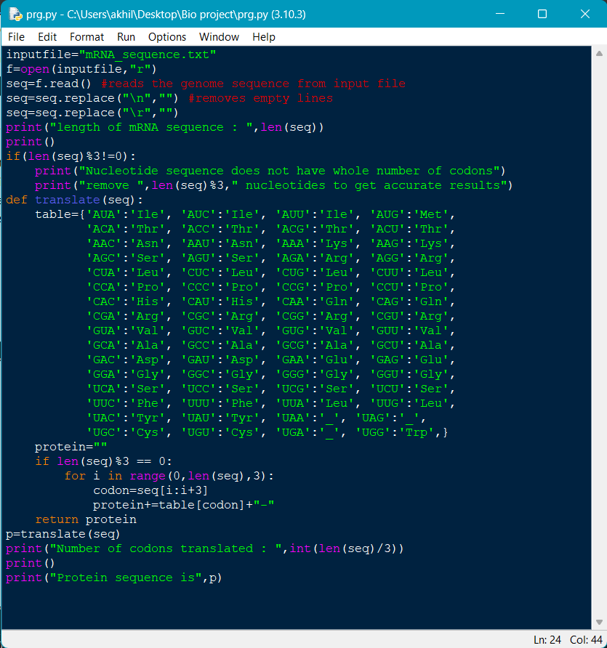
PYTHON CODE

Slide 27

Algorithm used
The code reads mRNA sequence from txt file
Then it trims any white spaces and empty lines from the sequence.
Then the code checks if the number of codons in the sequence is a whole number or not.
If no user is prompted to correct the number of nucleotides in the sequence.
If yes translation is done by taking one codon at a time and finding its key-value pair from the genetic code dictionary.
Number of codons translated and protein sequence generated is printed at the end of execution

Slide 28
Conclusion
The mRNA to amino acid sequence(protein) converter returns accurate results by recognizing each codon.
The code bio mimics the functionality of a Ribosome and tRNA
There are some regions in the mRNA before the start codon
These regions do not have an effect on amino acid sequence hence can be termed as silent.

